Slide 1
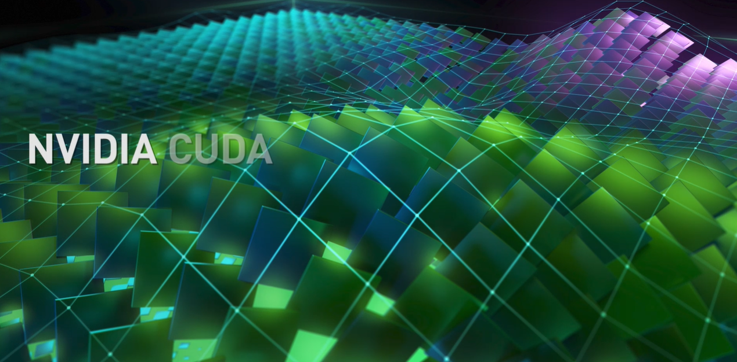


Introduction to Accelerated Computing using CUDA
2021.08.04
Karthik Bala
KBVIS Software Pty. Ltd., Brisbane, Australia
http://kbvis.com
3d@kbvis.com

Slide 2
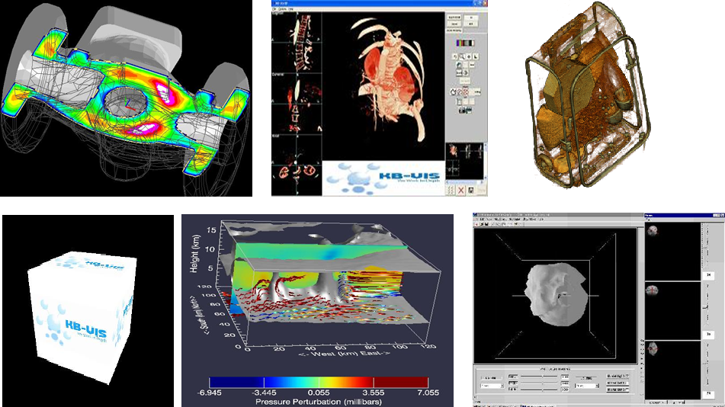












About KBVIS
Clients

Slide 3

Agenda
DAY 1
CUDA - Background, History, Motivation
Introduction to Massively Parallel Computing
Introduction to GPU-based Programming
CUDA Overview
Getting Started with CUDA
CUDA SDK, Samples (Windows) - Overview
Nvidia Courseware, VM usage, Exercises - Overview
Anatomy of a CUDA Program
Introduction to CUDA Syntax
“Hello World”
Vector Addition

Slide 4
Agenda (tentative)
DAY 2
CUDA Memory Model
Unified Memory
Thread Hierarchy
DAY 3
Shared Memory
CUDA Samples
DAY 4
Asynchronicity
Streams
Dynamic Parallelism
CUDA Samples
DAY 5
Scan/Reduction
Atomic operations
CUDA Samples
DAY 6
Image Processing
Textures
Graphics Interop
DAY 7
Profiling and Debugging
Nsight
DAY 8
Advanced Topics – Quick Peek
Tools/Libraries
Questions / Recap
Feel free to suggest changes/additions!

Slide 5
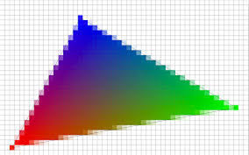
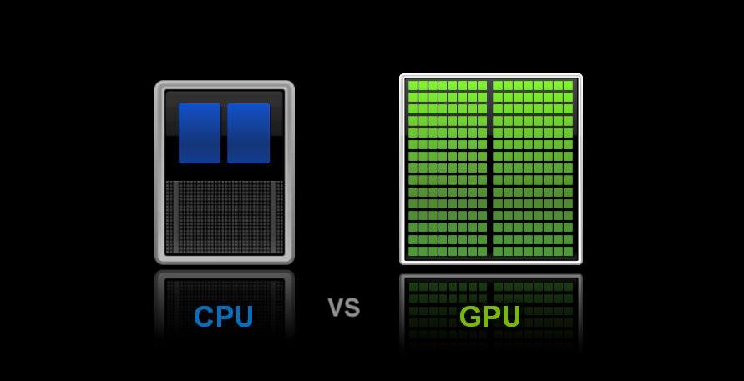
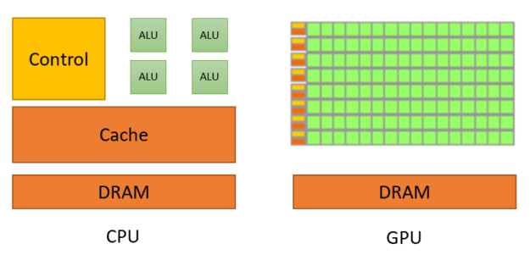
Dawn of GPGPU
Since 2005 – Shift to Parallelism rather than Transistor-density
GPUs are designed for massively parallel computation:
Vertex and Fragment Shaders run in parallel – data locality (Cg, GLSL, HLSL)
Graphics/Shading essentially floating point computation
GPGPU aimed to exploit graphics hardware for computation
CPU – high complexity, low latency
GPU – high throughput, data-centric

Slide 6
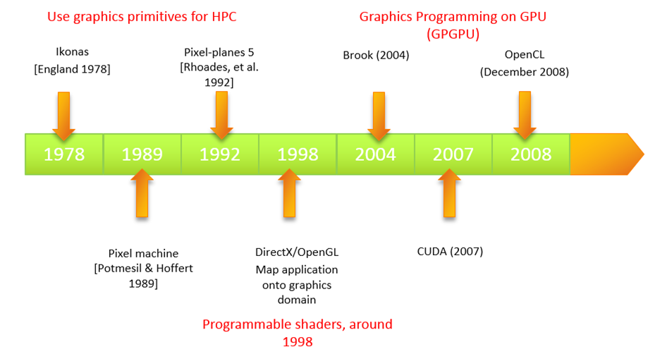
GPGPU Evolution

Slide 7
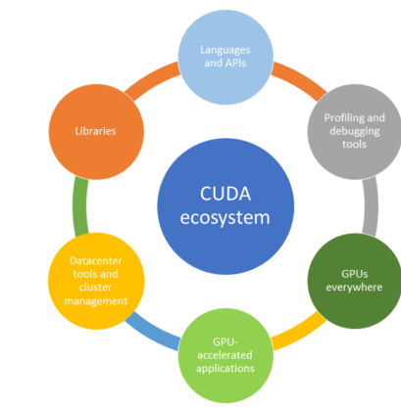
CUDA Ecosystem
HPC
Medical Imaging
Simulation
Graphics & Visualization
Computer Vision
Data Science
Machine Learning, AI
Autonomous Vehicles

Slide 8
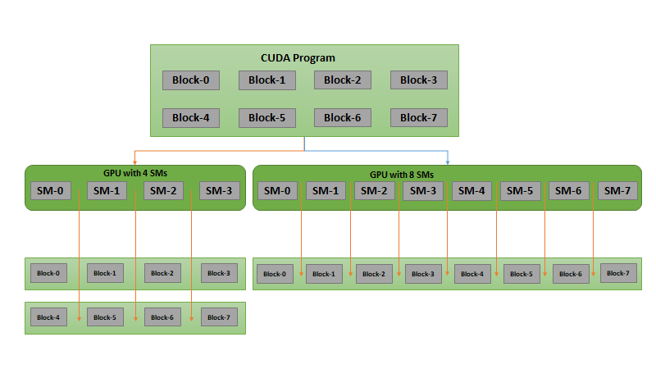
Introduction to CUDA
Launched by Nvidia in 2006
C-API for Parallel Computation
Familiar syntax
Easily scalable across GPUs
CUDA Toolkit – compiler, toolchain, libraries, runtime

Slide 9
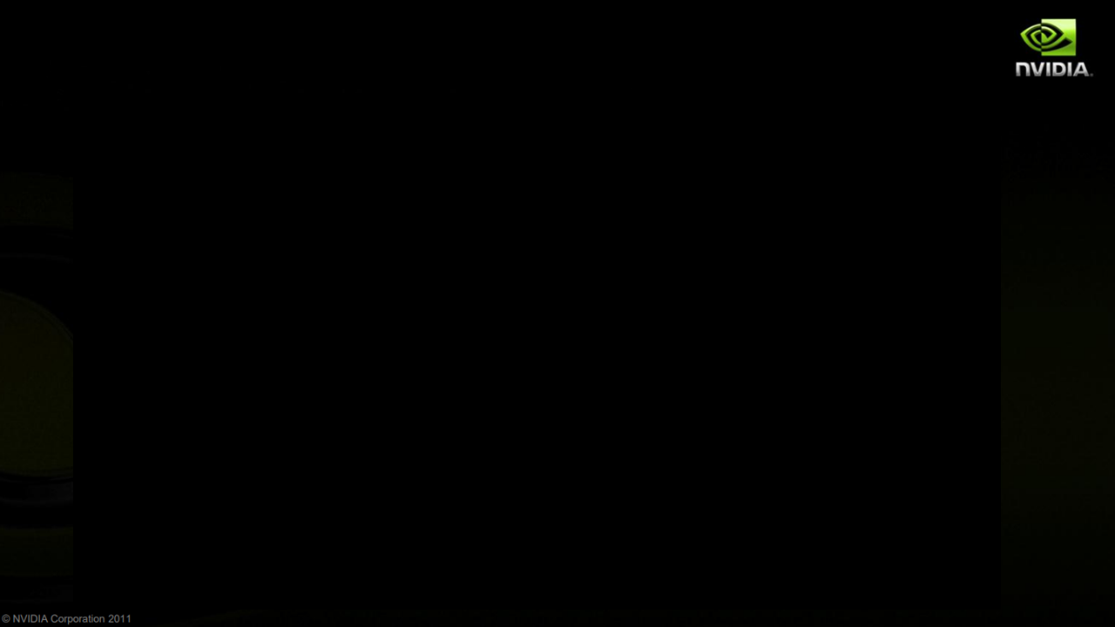
CUDA Resources
Developer Zone: https://developer.nvidia.com/cuda-toolkit
Download: https://developer.nvidia.com/cuda-downloads
Documentation:
CUDA Programming_Guide (PDF)
CUDA Best Practices (PDF)
Training: https://developer.nvidia.com/accelerated-computing-training
Nvidia Online Course Login: https://courses.nvidia.com/courses/course-v1:DLI+C-AC-01+V1/about

Slide 10
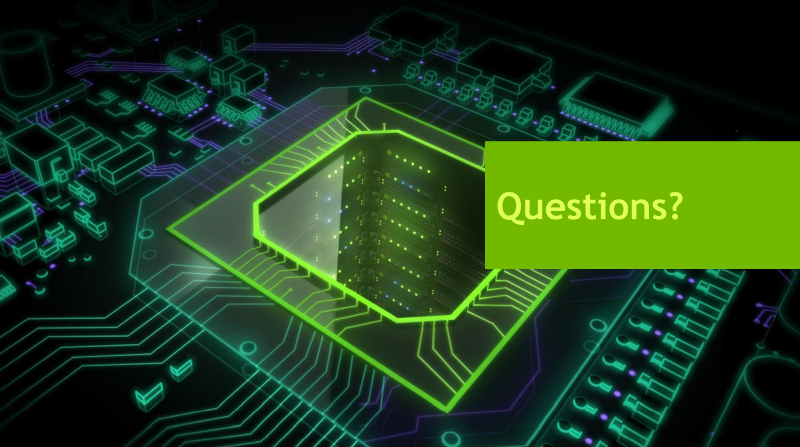

Slide 11
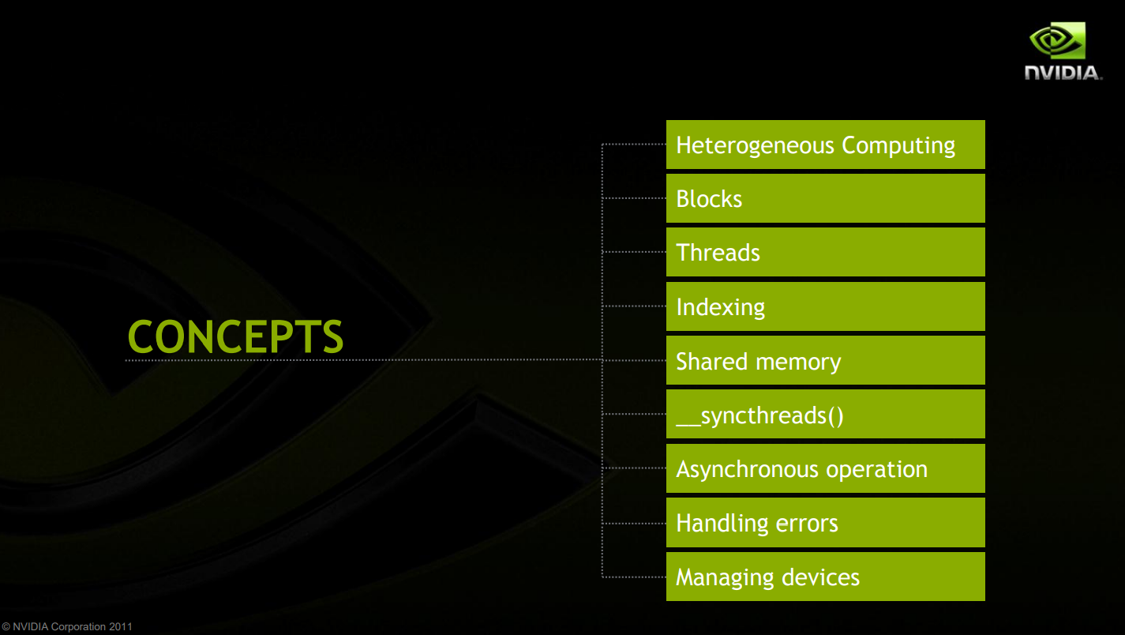

Slide 12
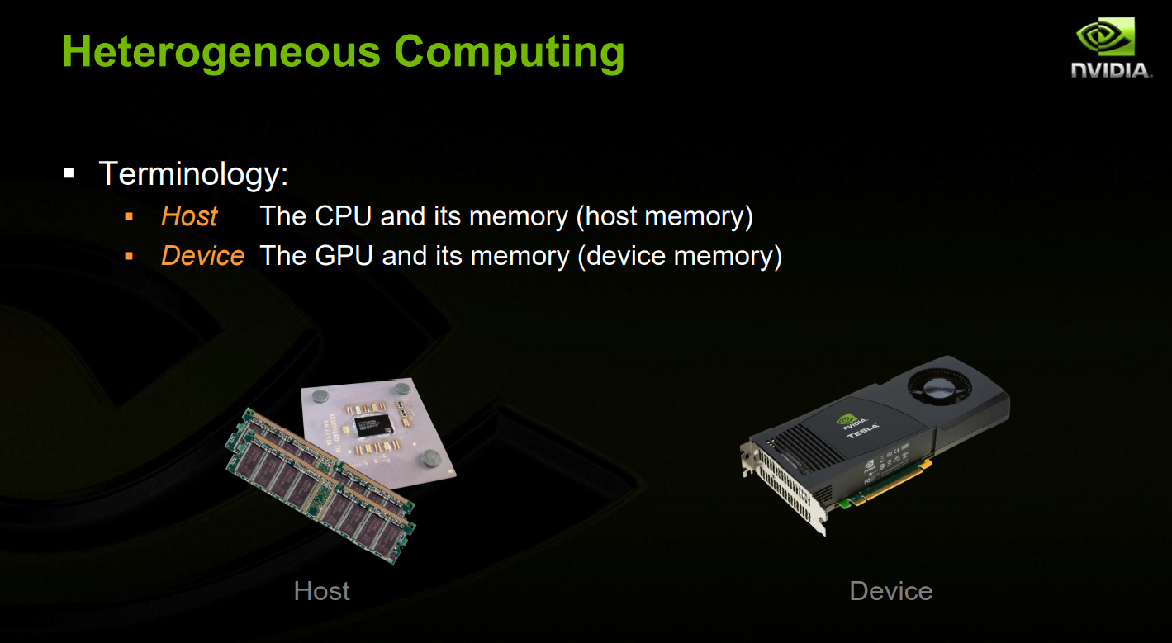

Slide 13
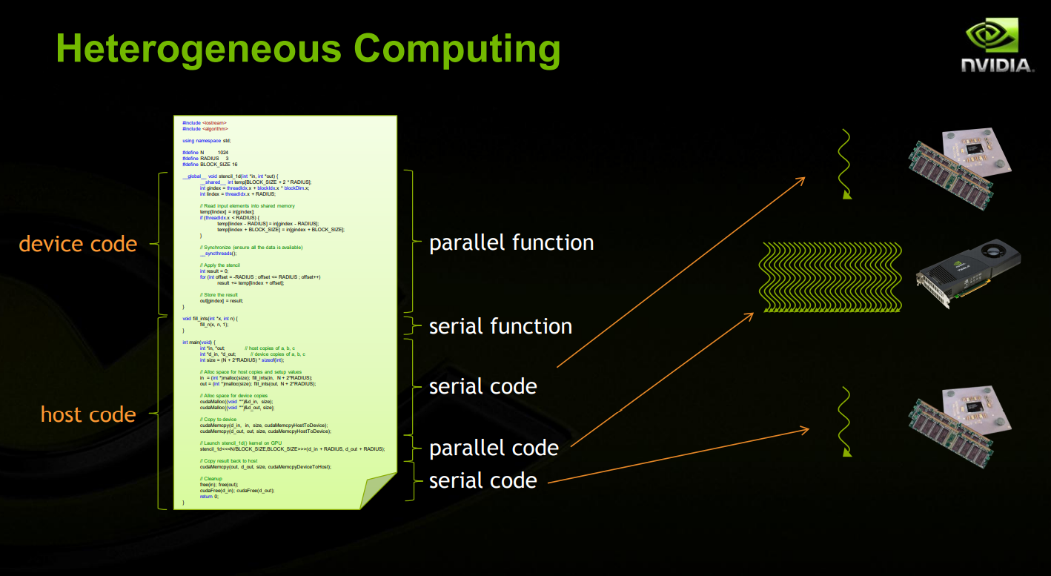

Slide 14
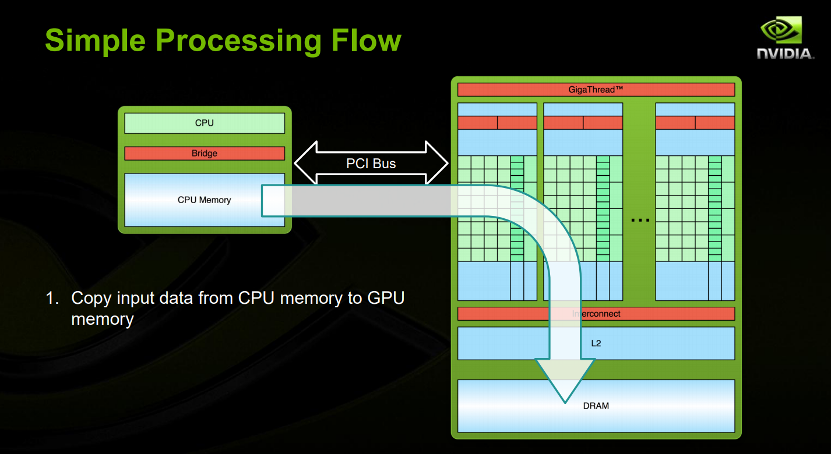

Slide 15
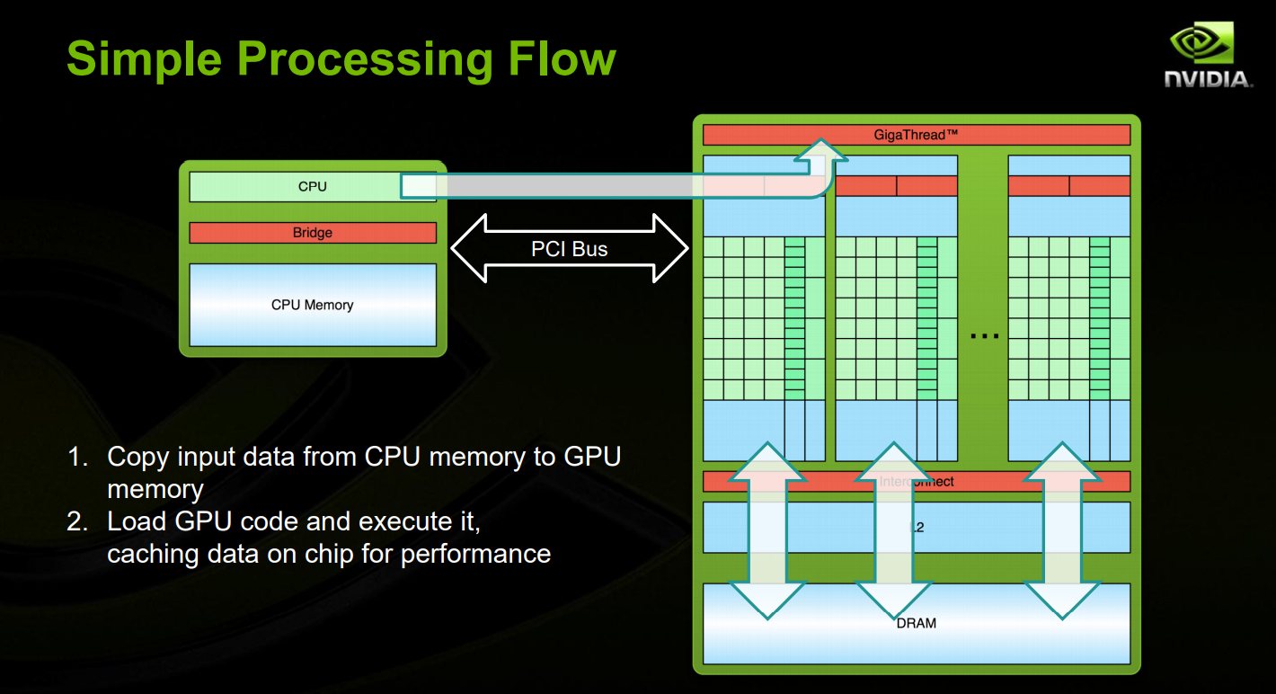

Slide 16
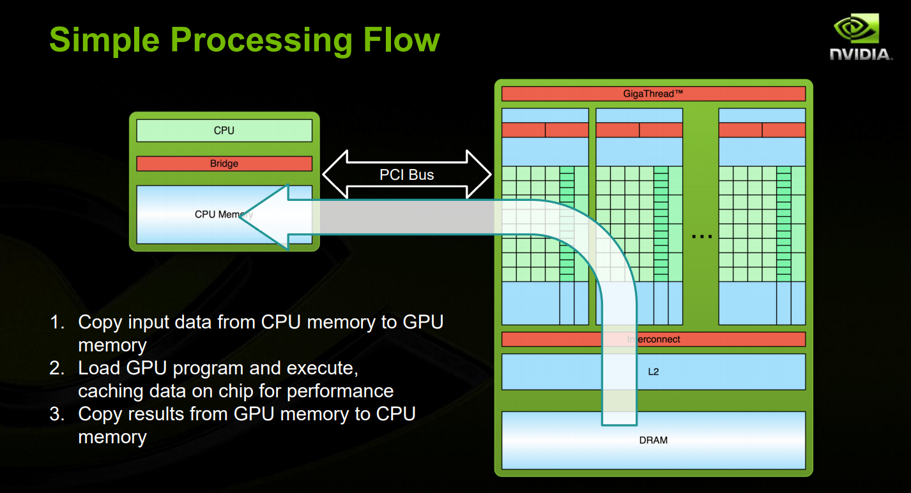

Slide 17
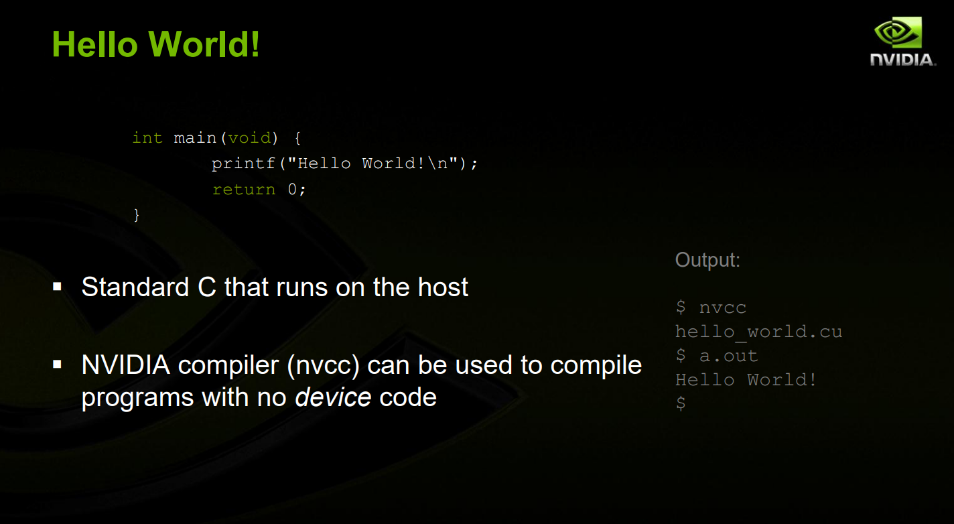

Slide 18
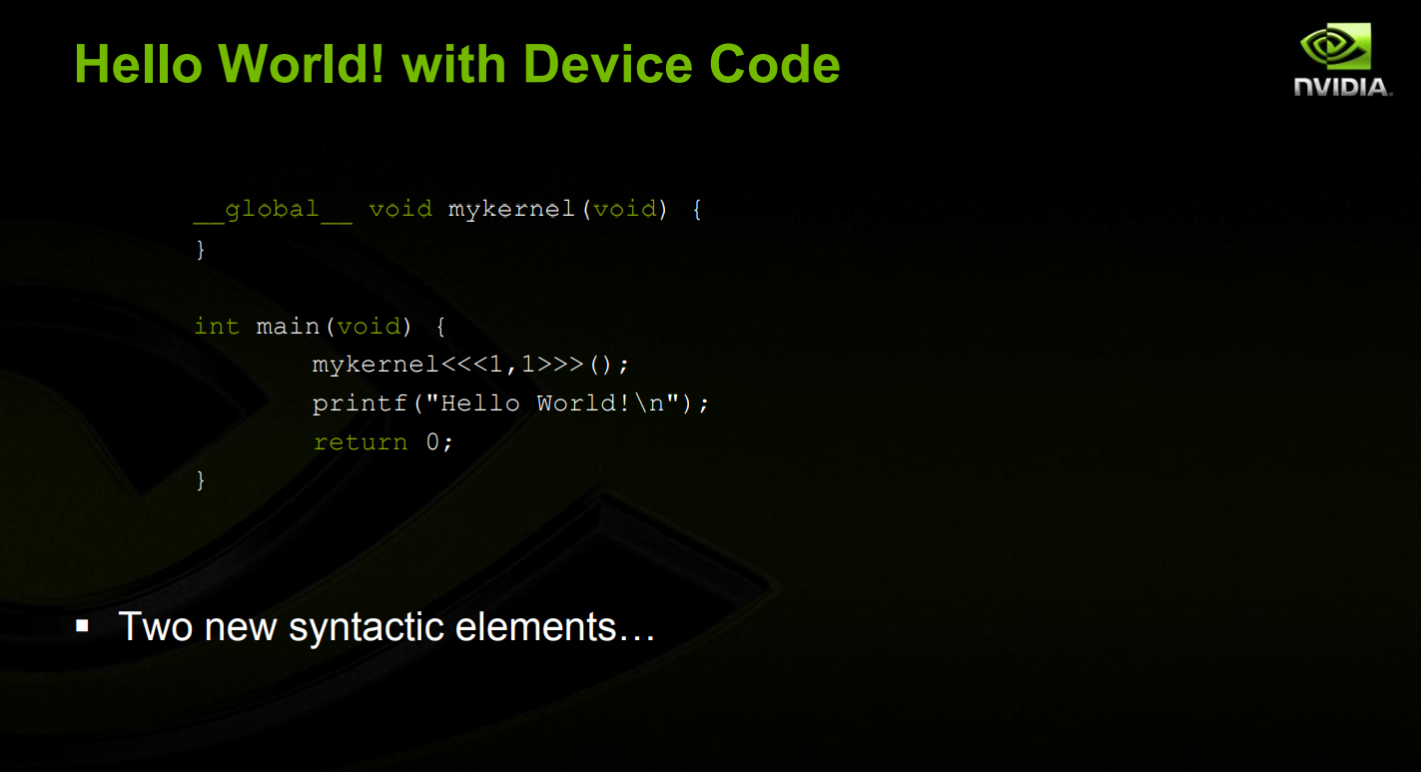

Slide 19
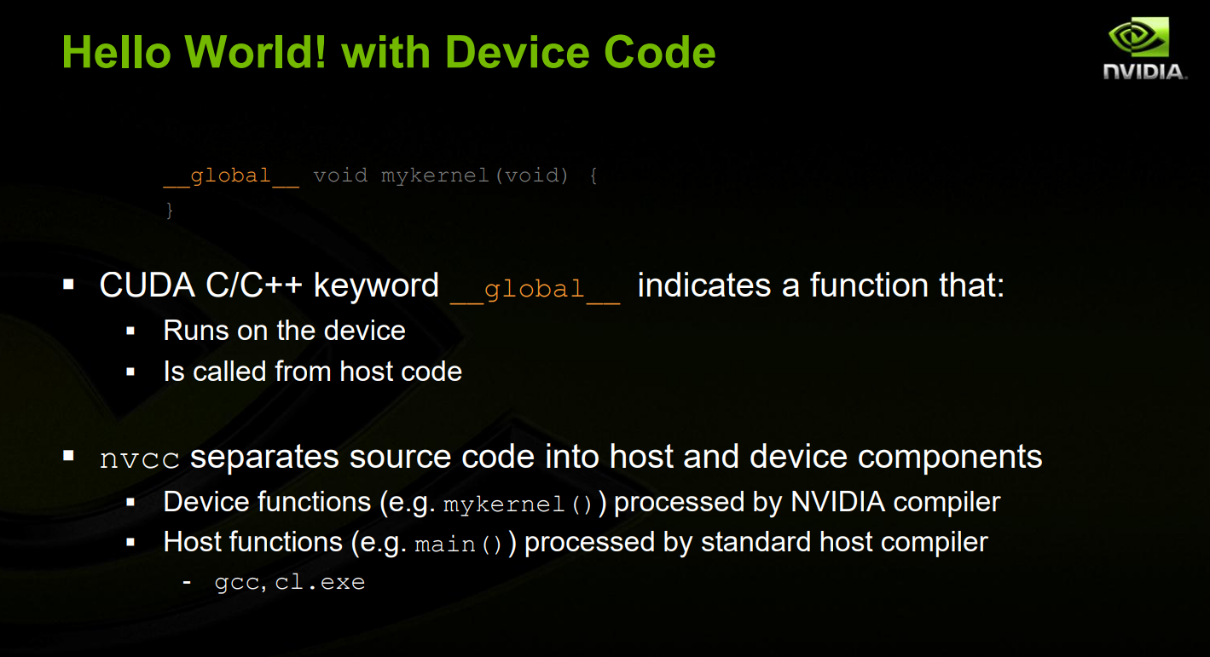

Slide 20
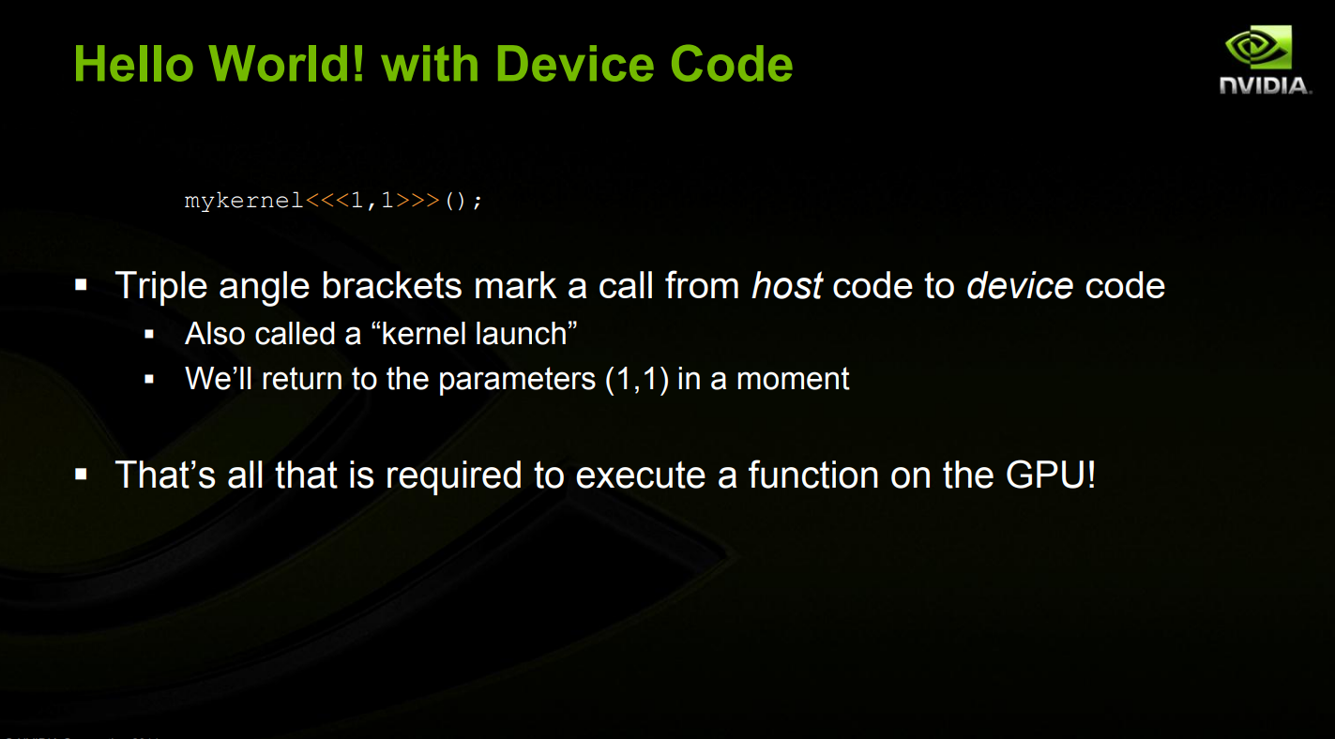

Slide 21
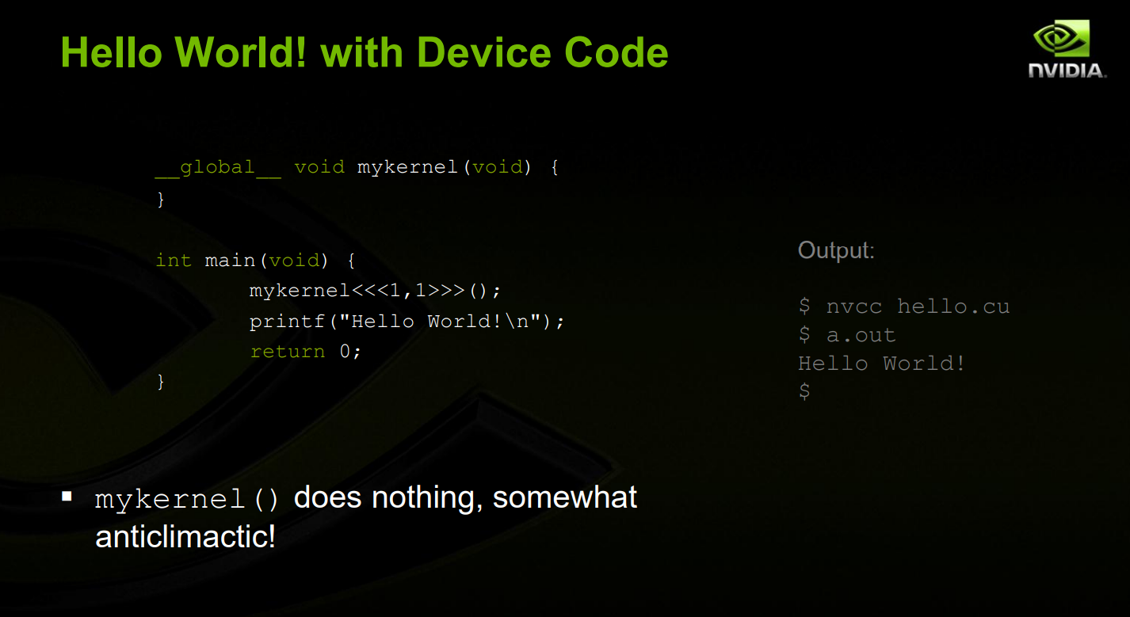

Slide 22
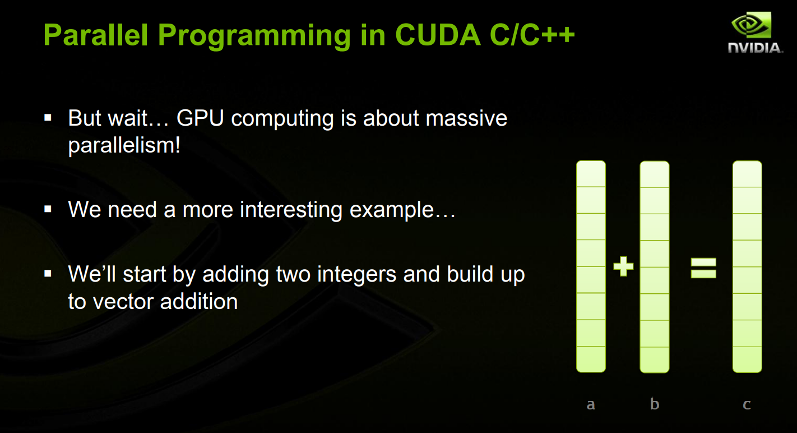

Slide 23
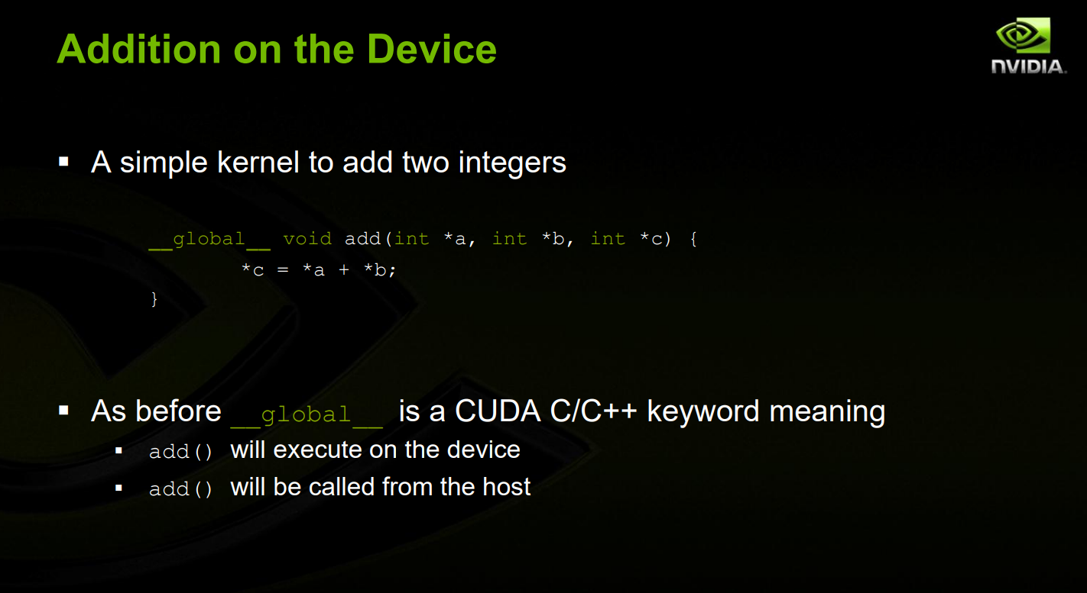

Slide 24
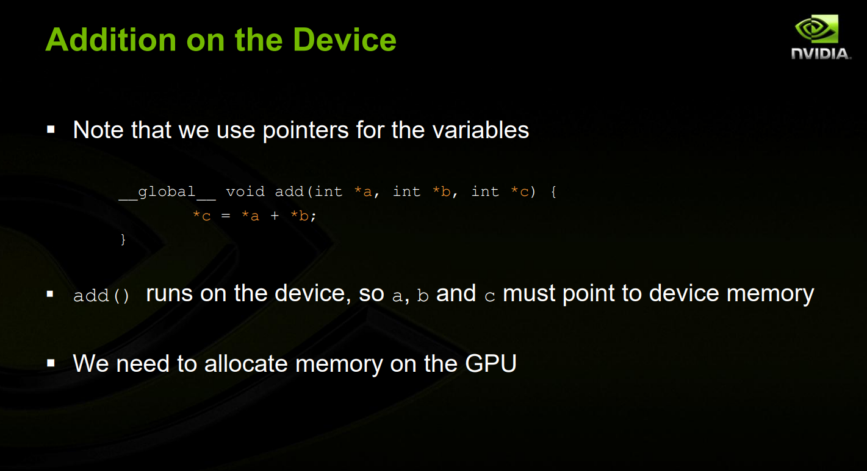

Slide 25
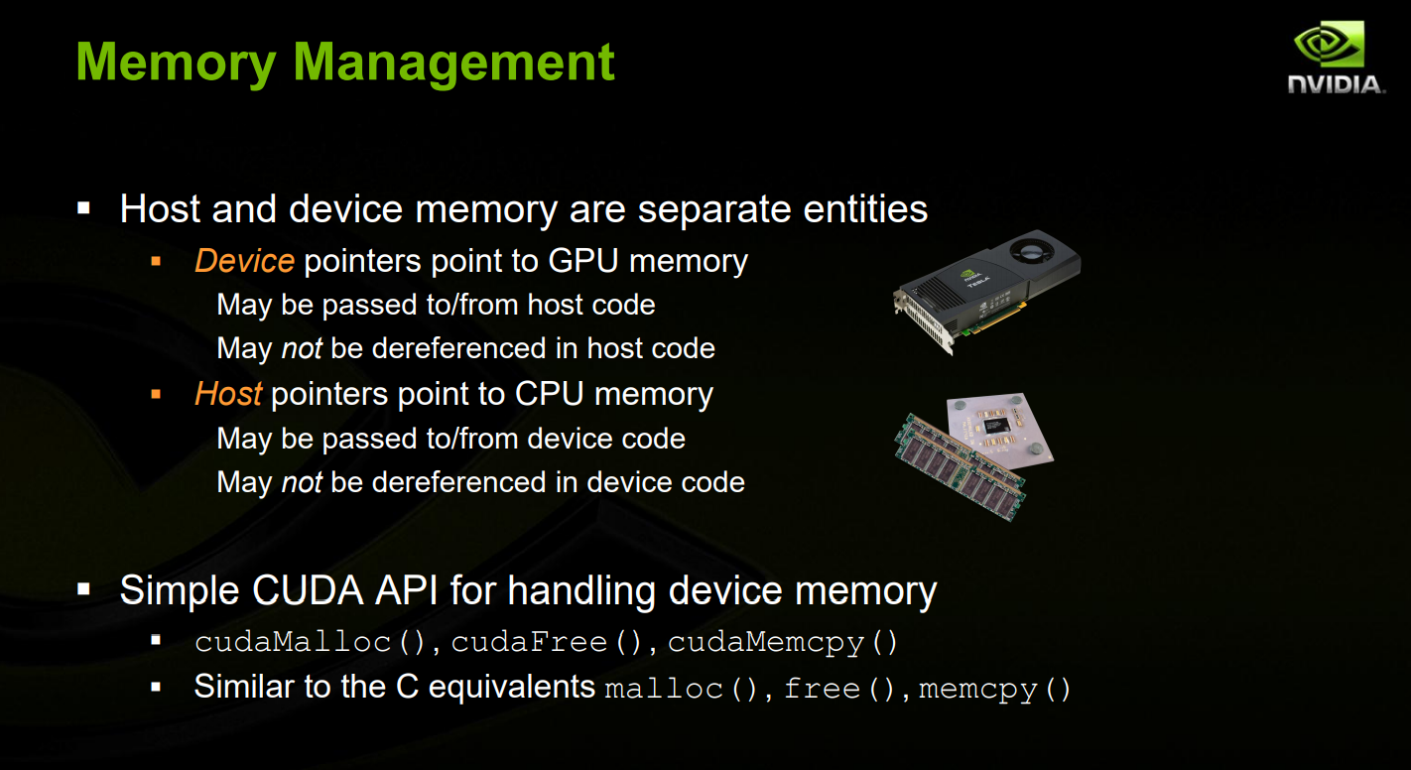

Slide 26
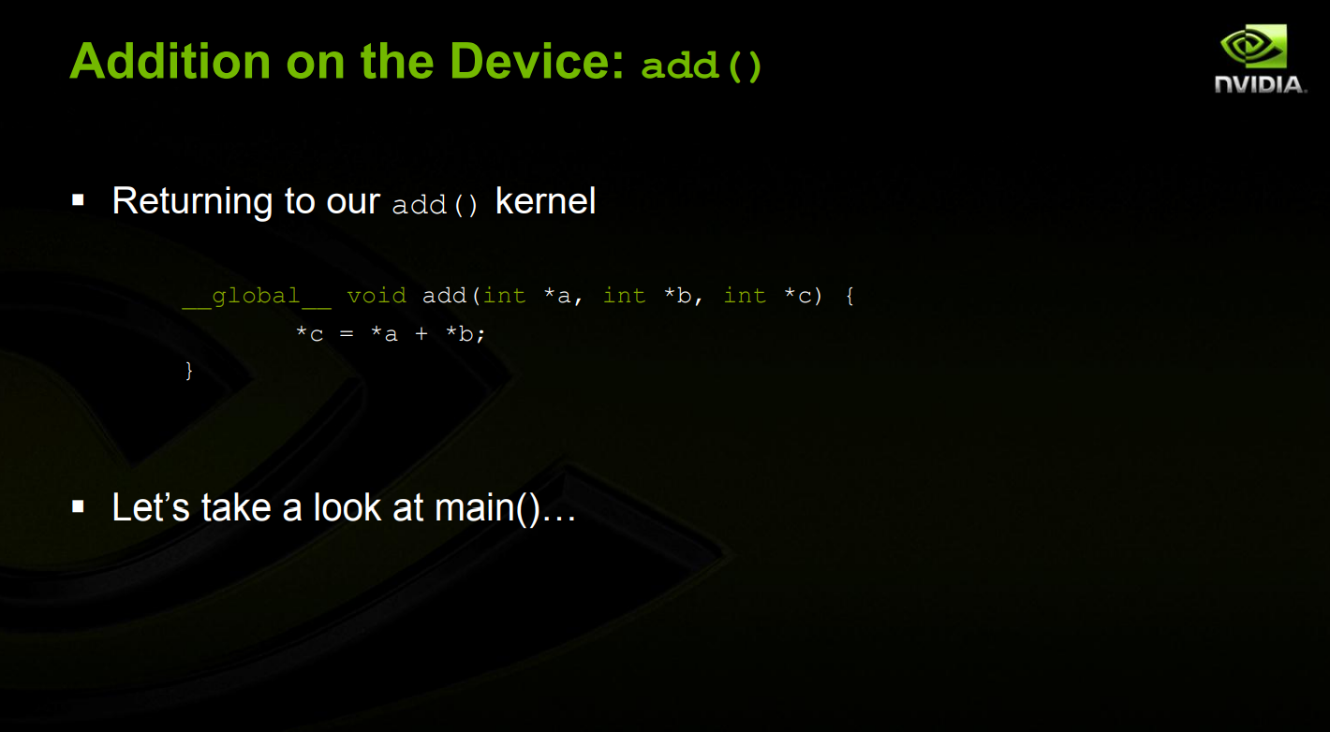

Slide 27
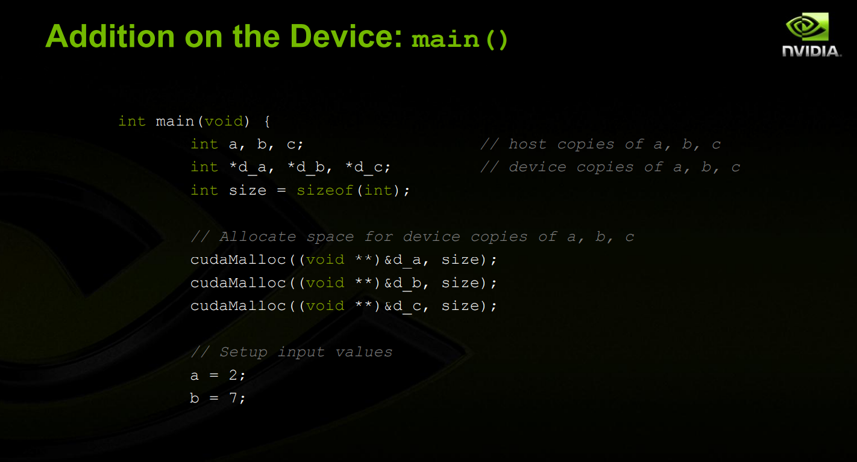

Slide 28
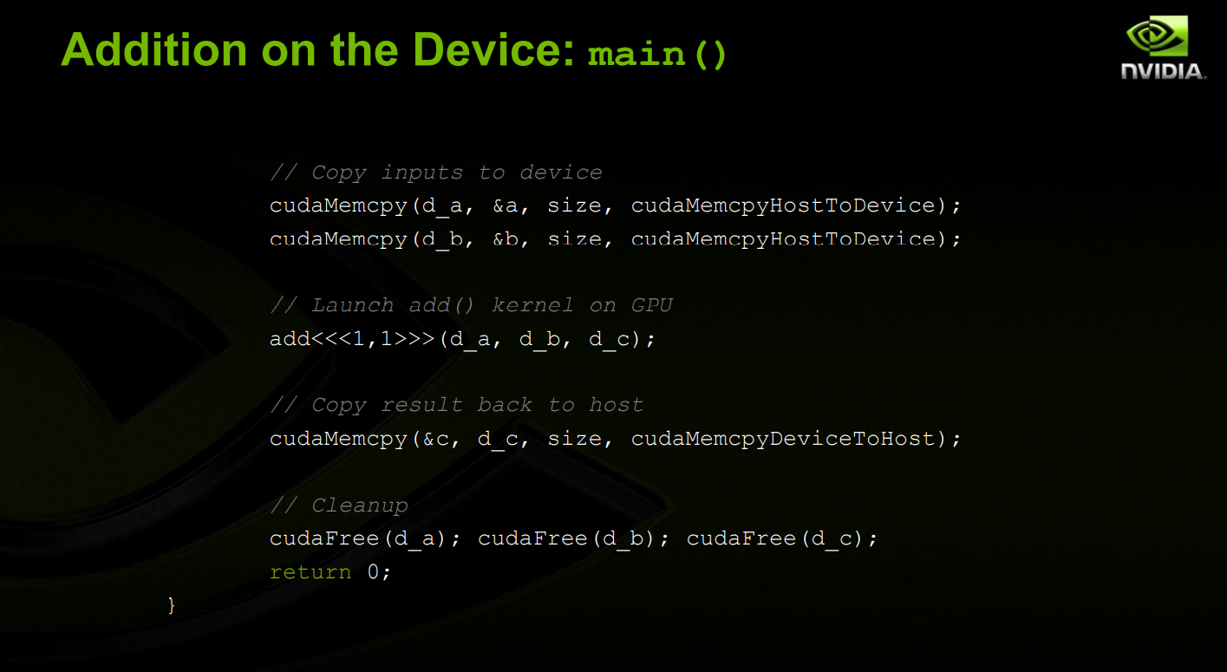

Slide 30
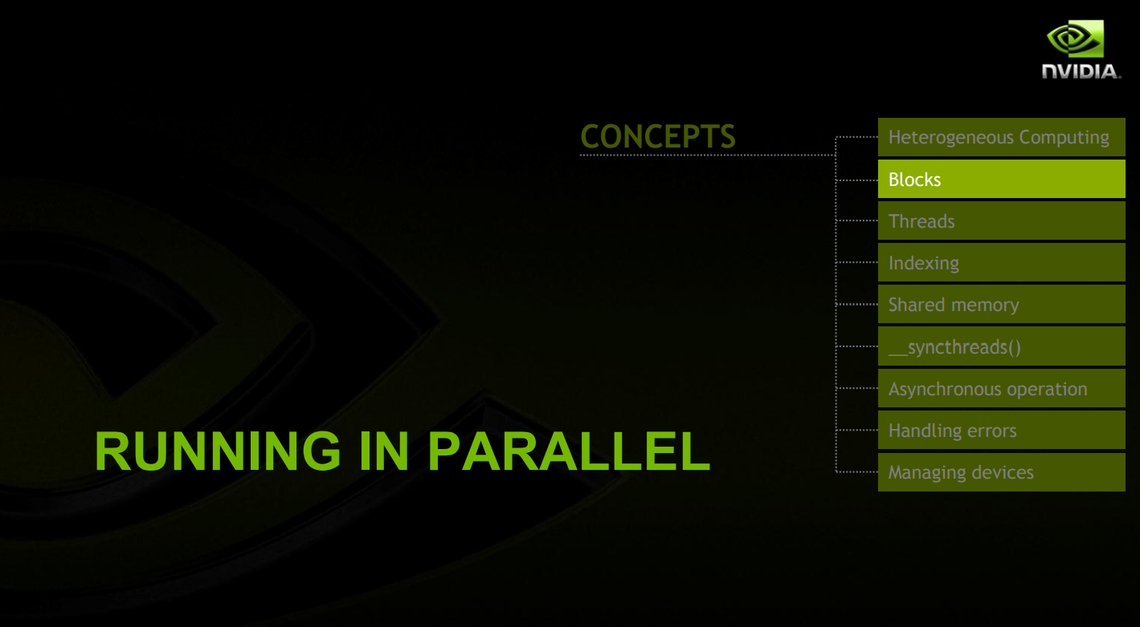

Slide 31
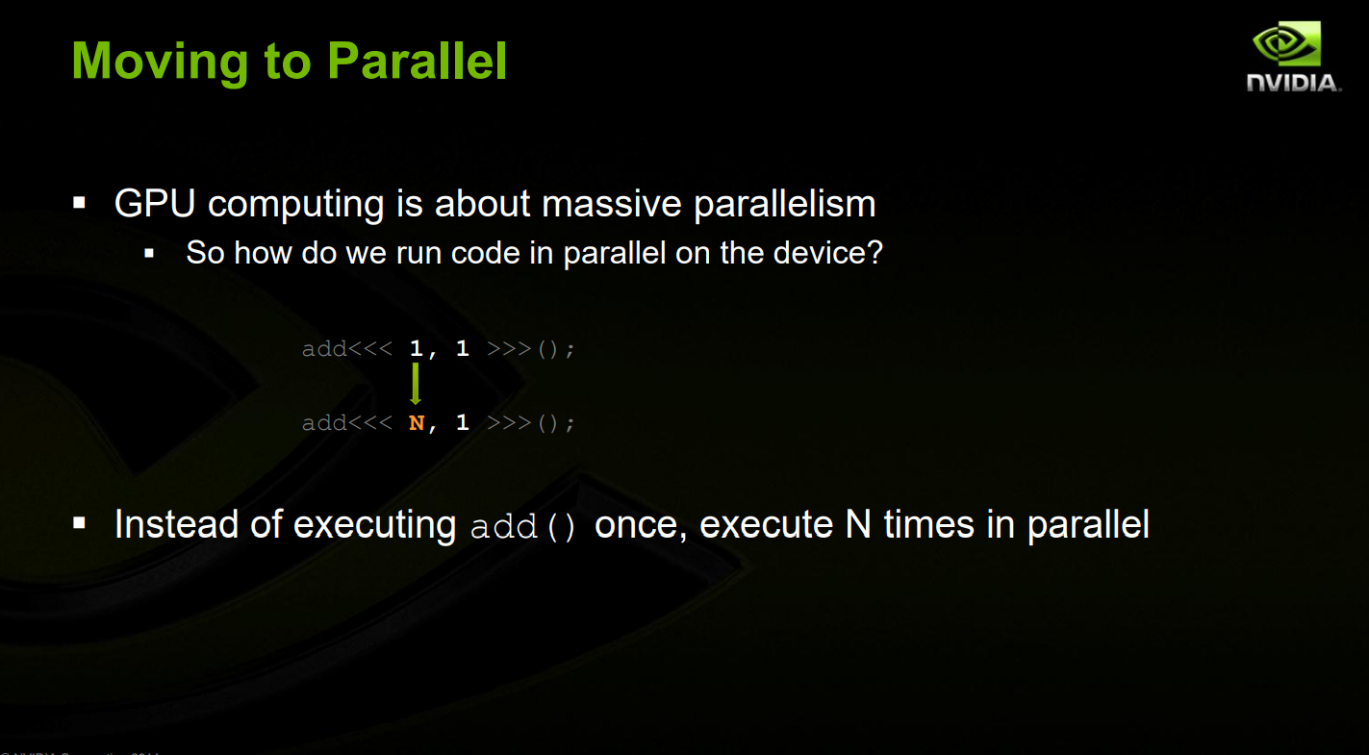

Slide 32
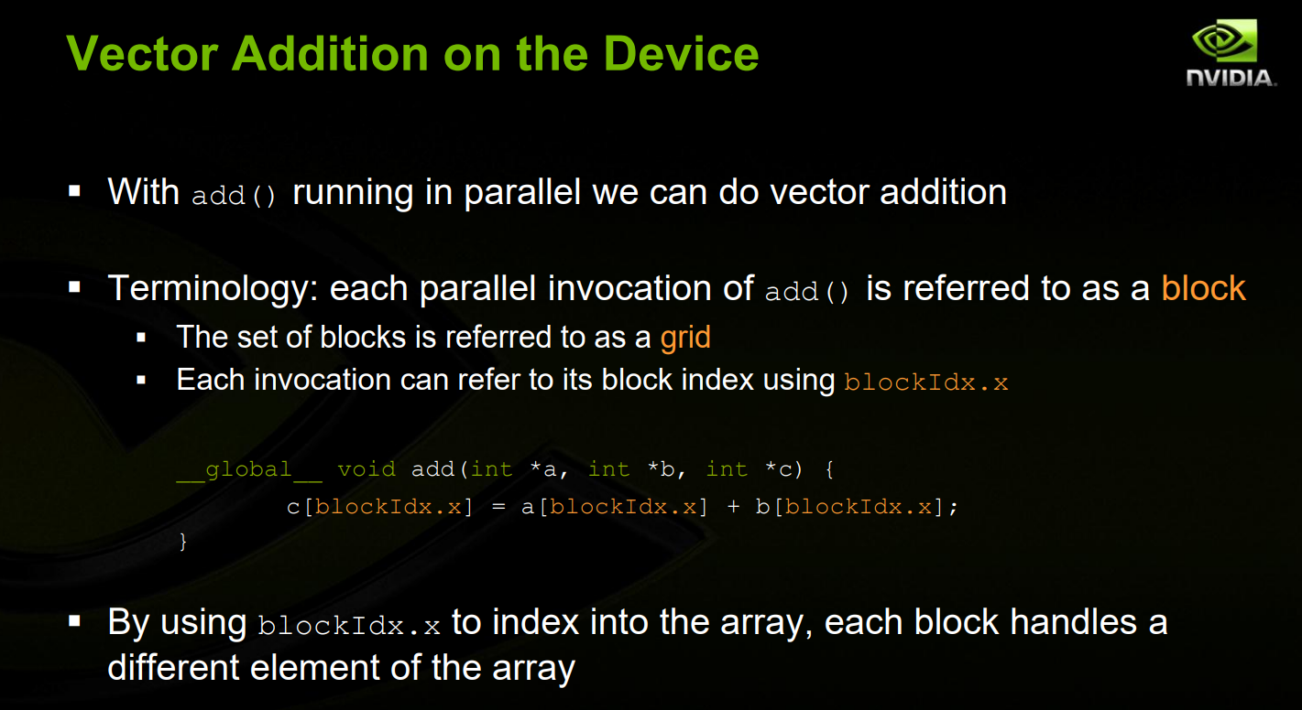

Slide 33
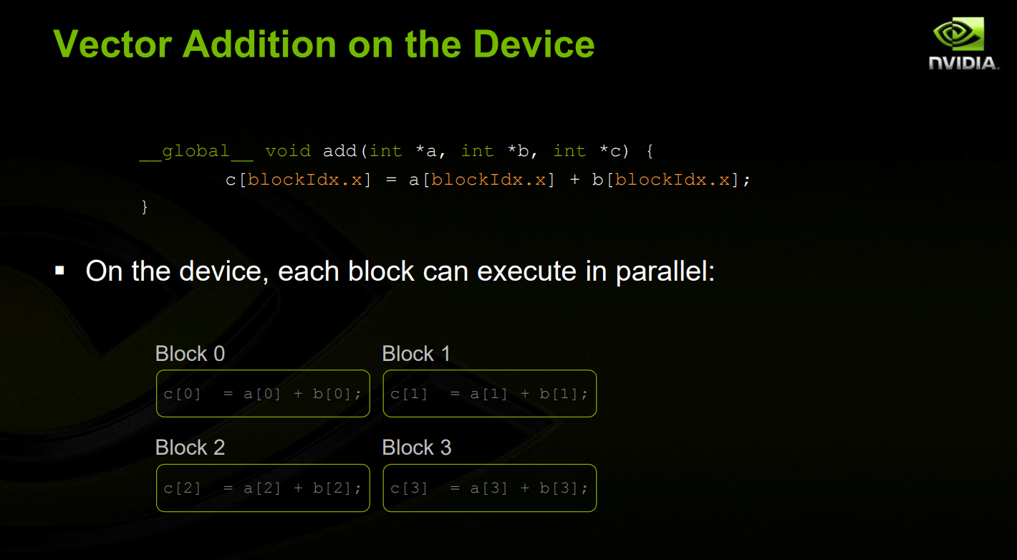

Slide 34
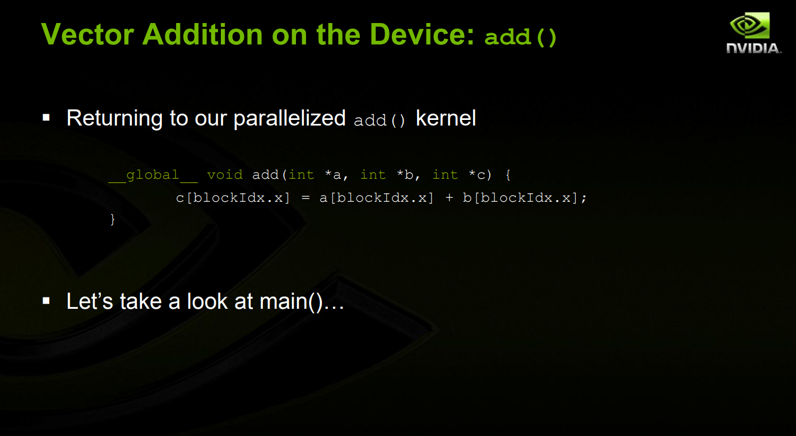

Slide 35
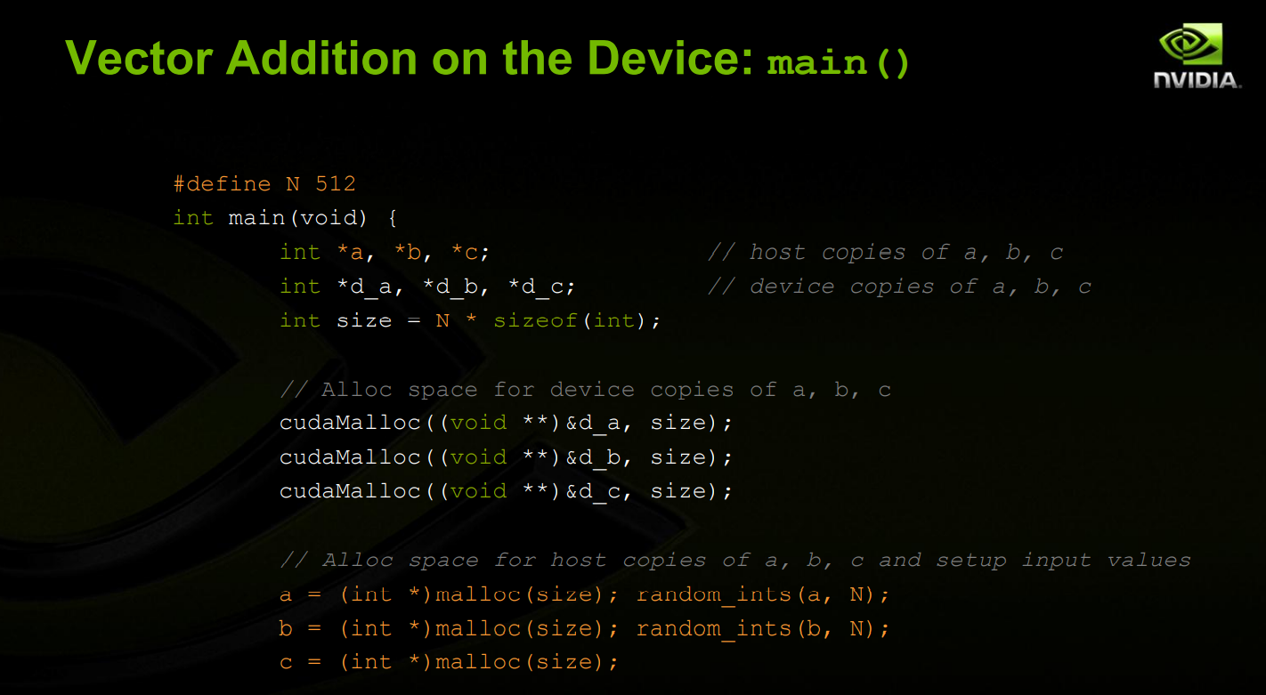

Slide 36
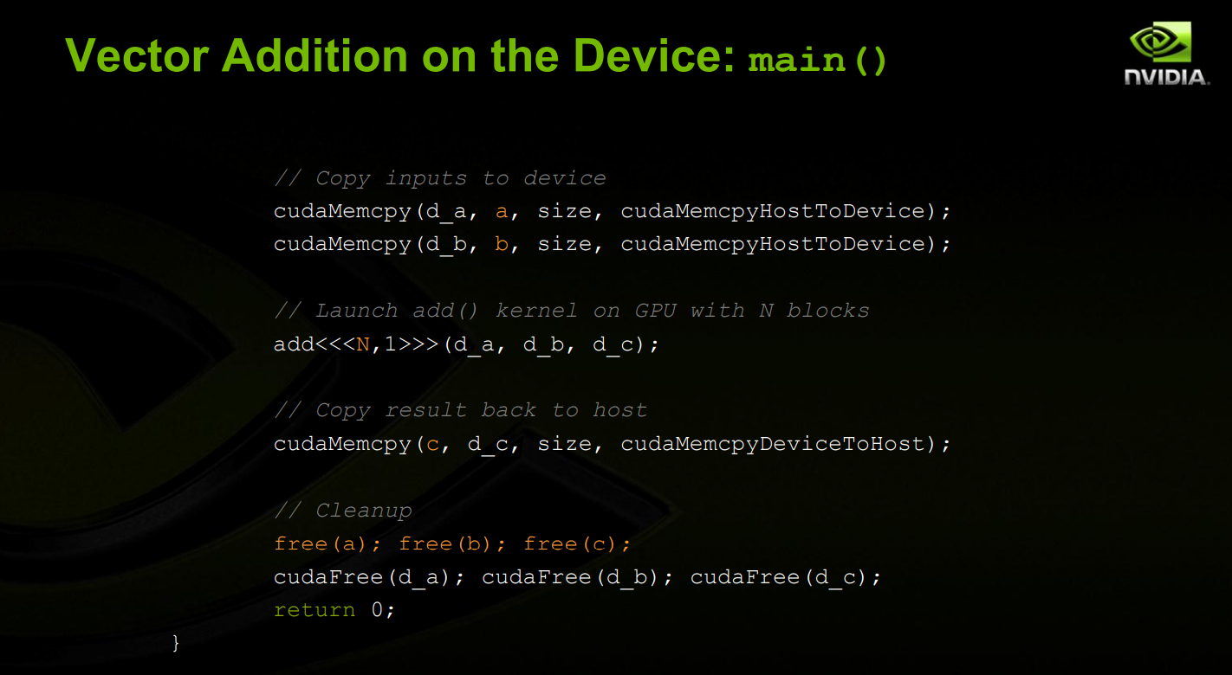

Slide 37
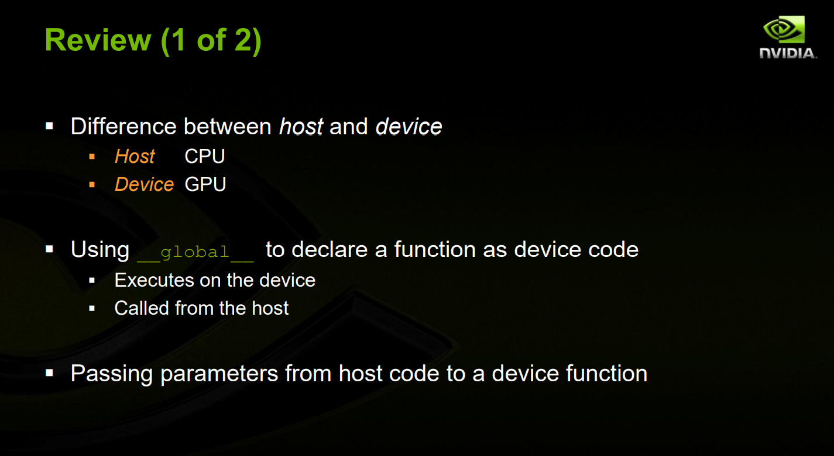

Slide 38
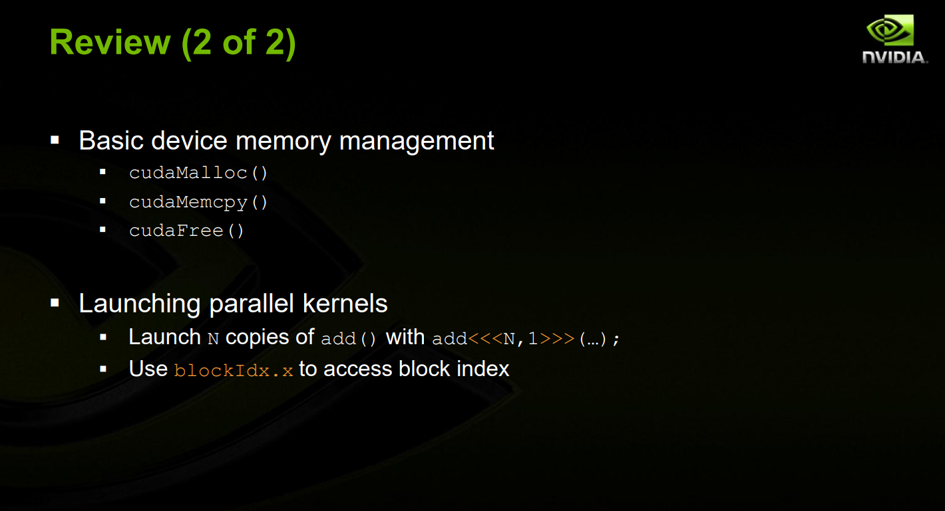

Slide 40
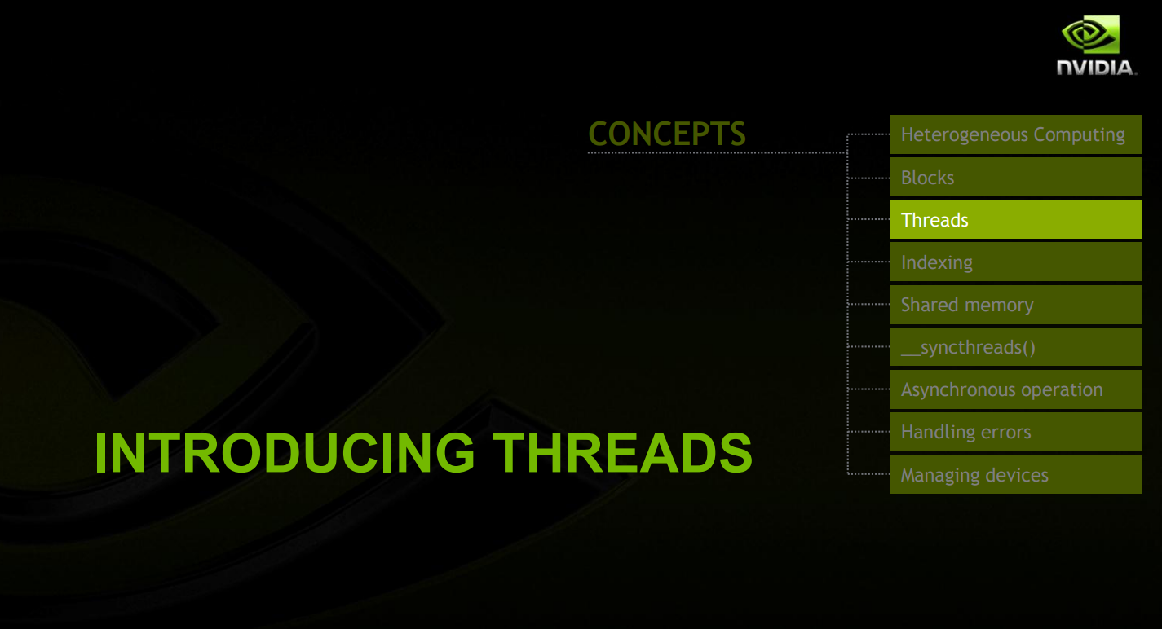

Slide 41
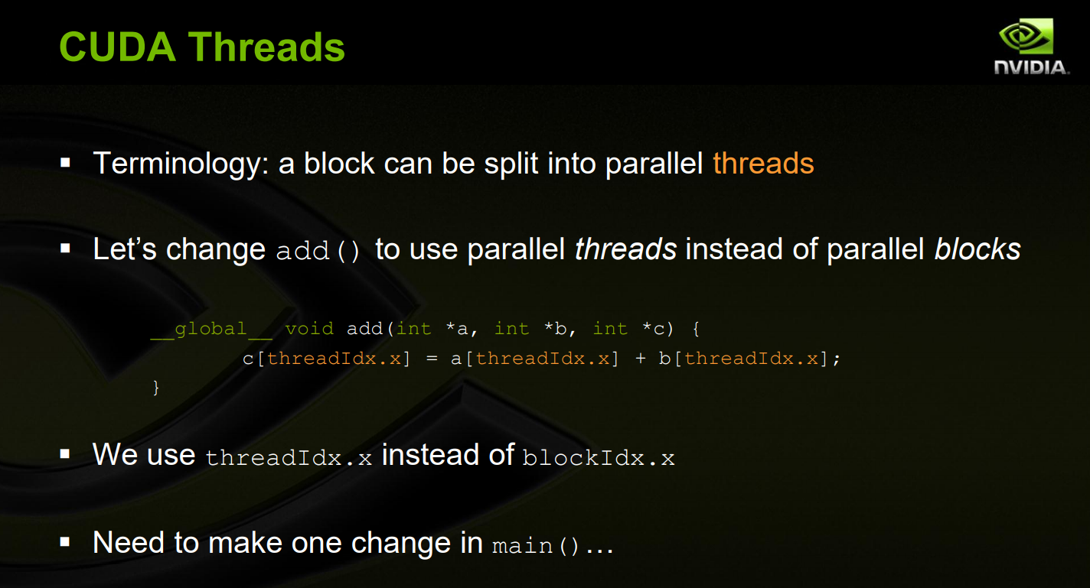

Slide 42
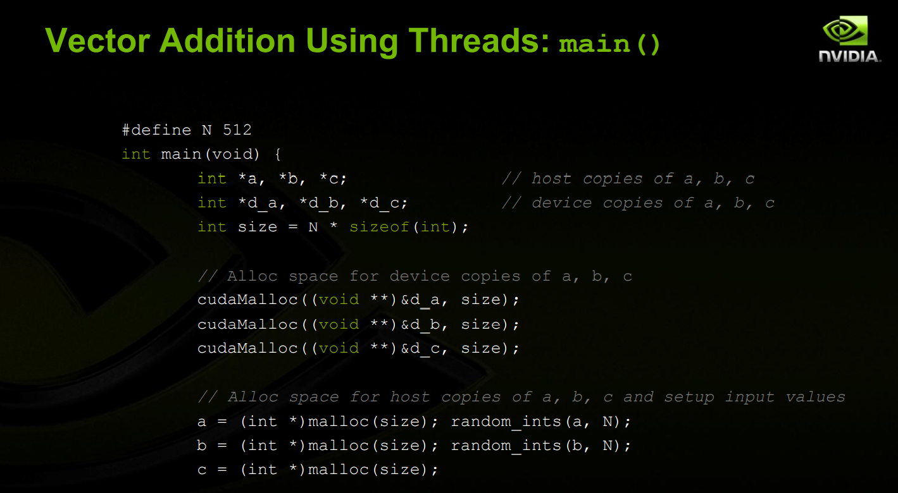

Slide 43
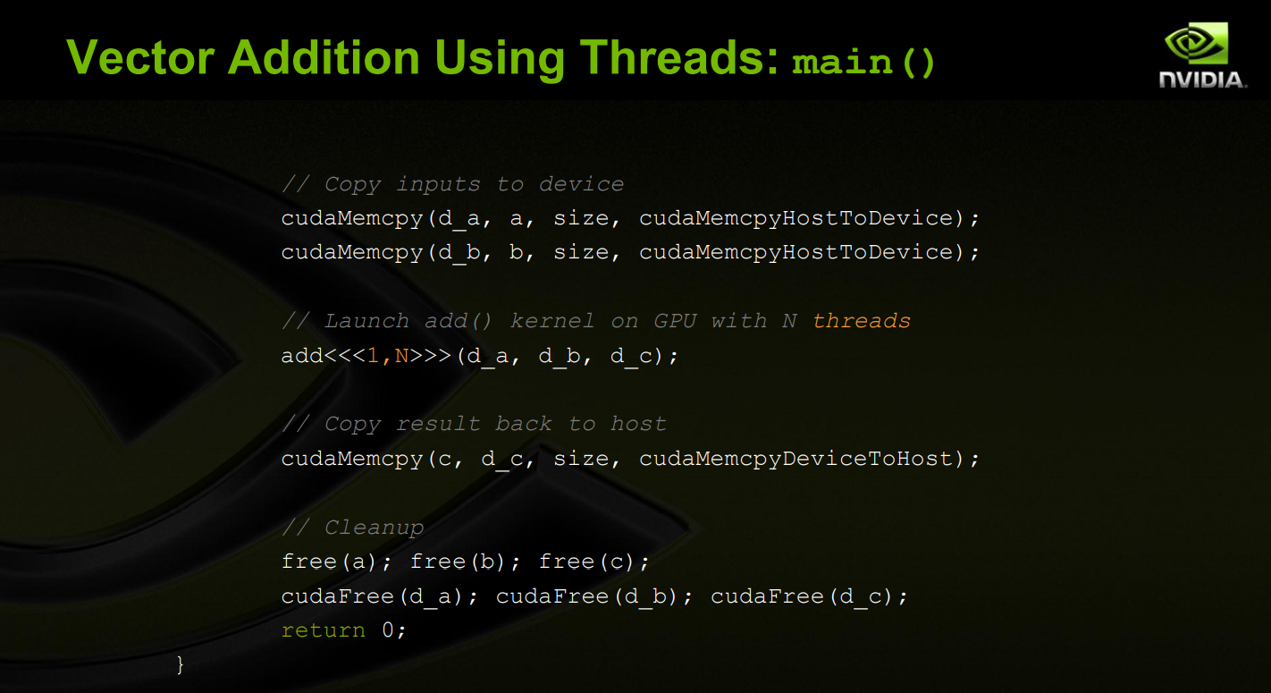

Slide 45
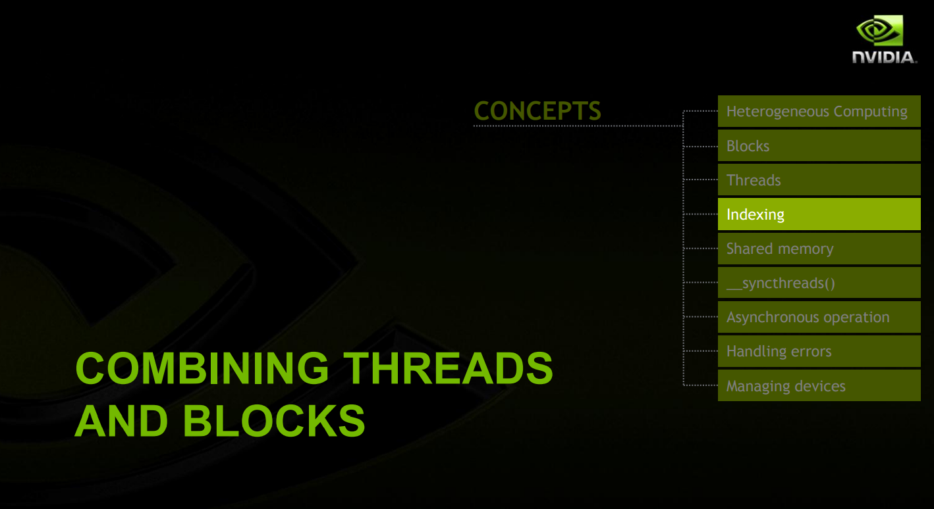

Slide 46
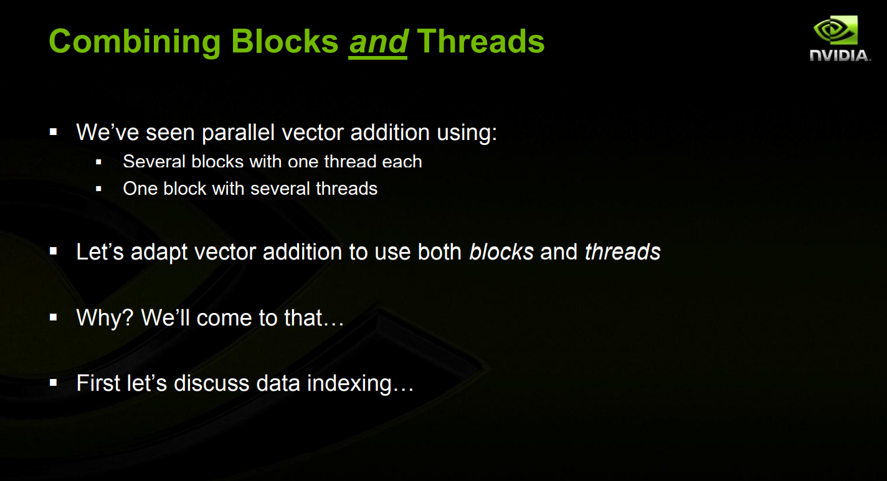

Slide 47
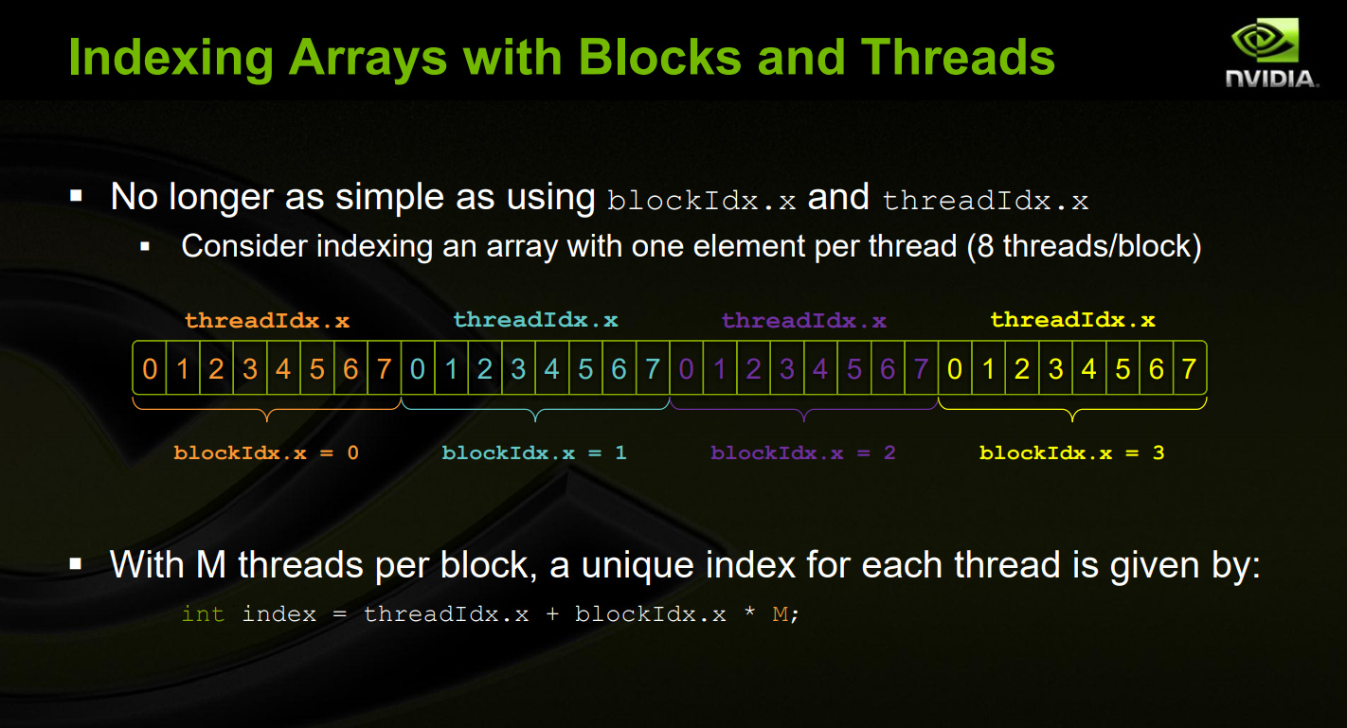

Slide 48
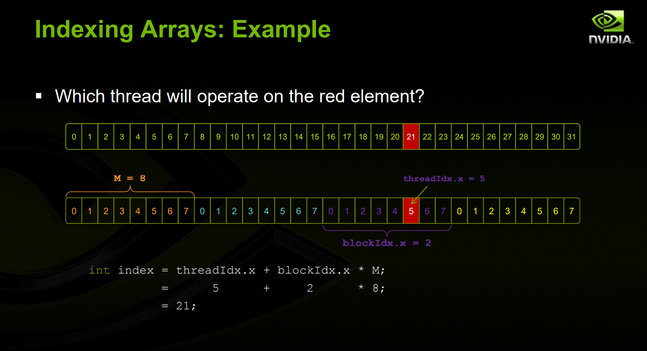

Slide 49
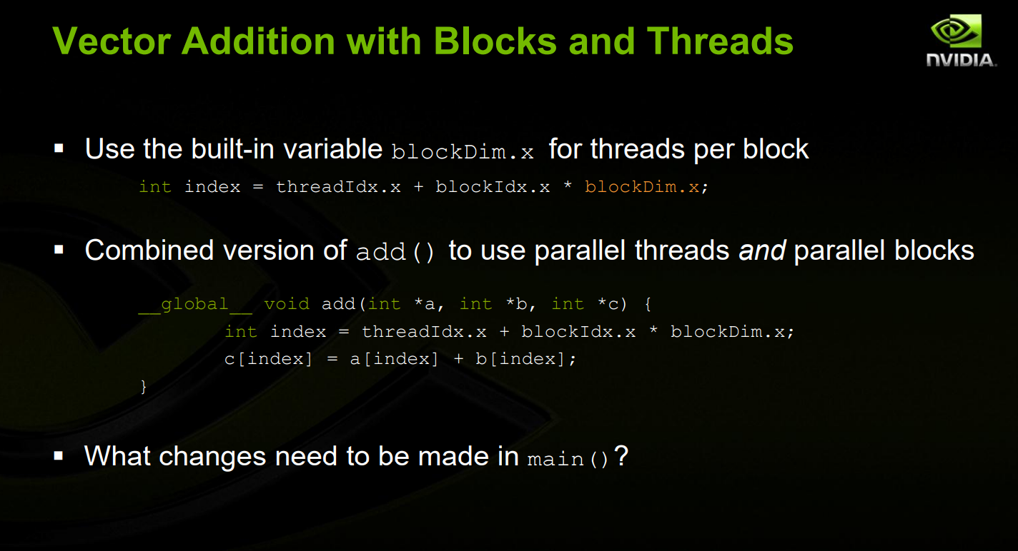

Slide 50
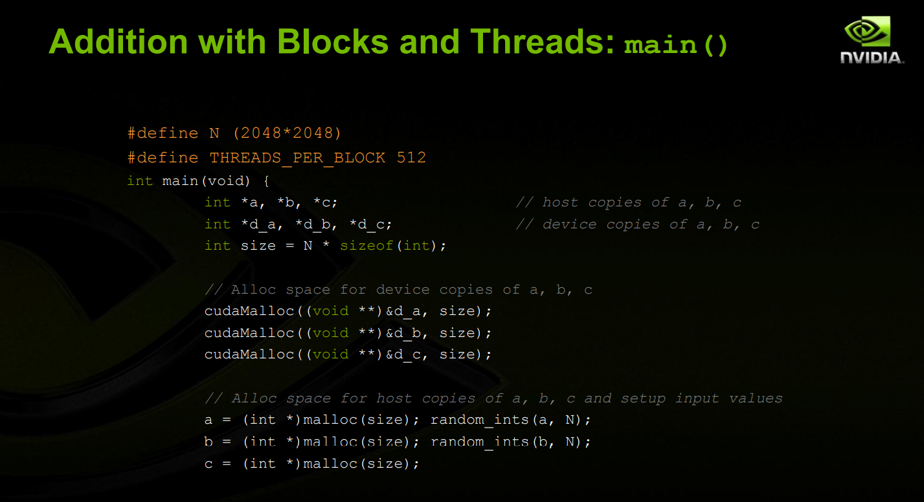

Slide 51
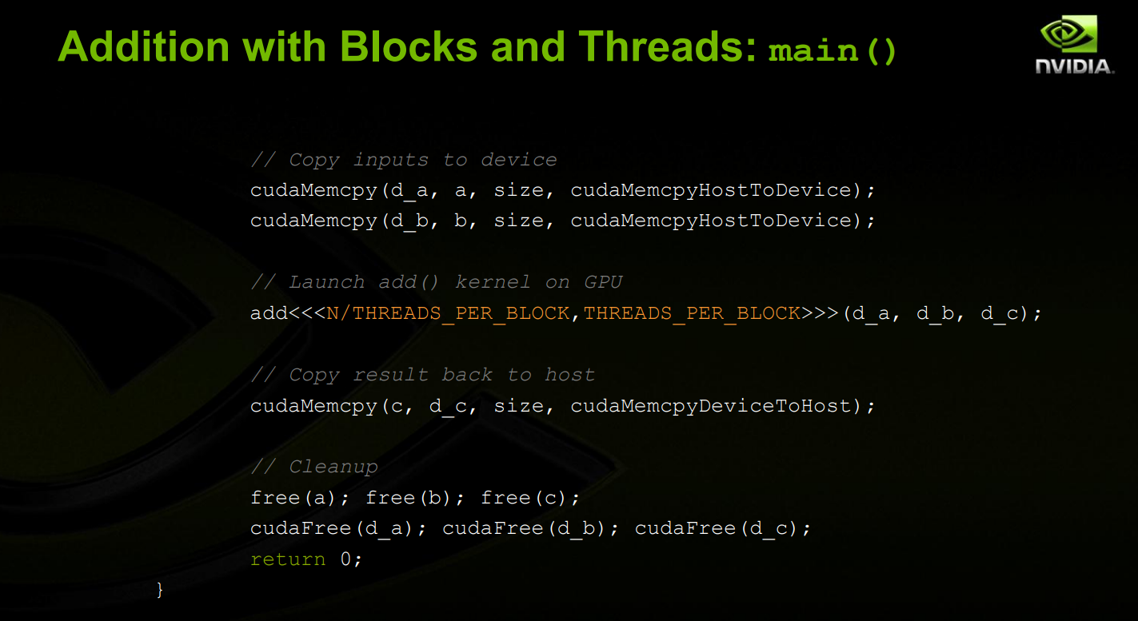

Slide 52
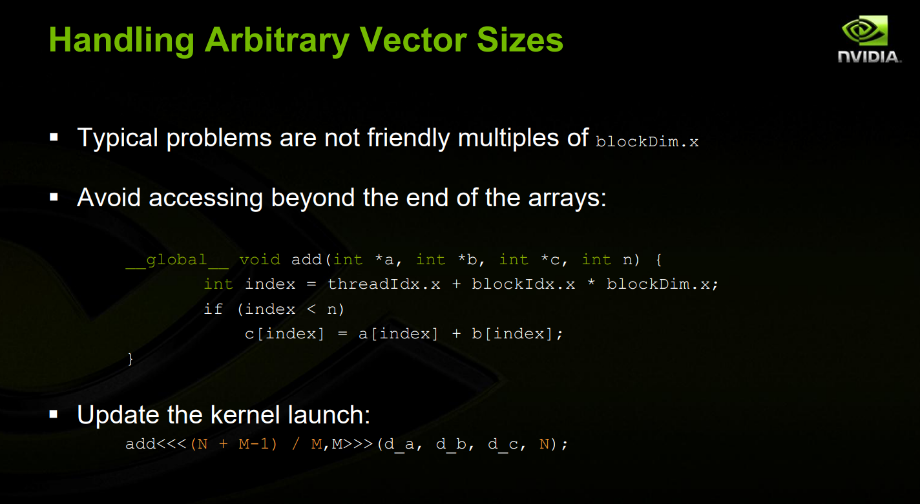

Slide 54
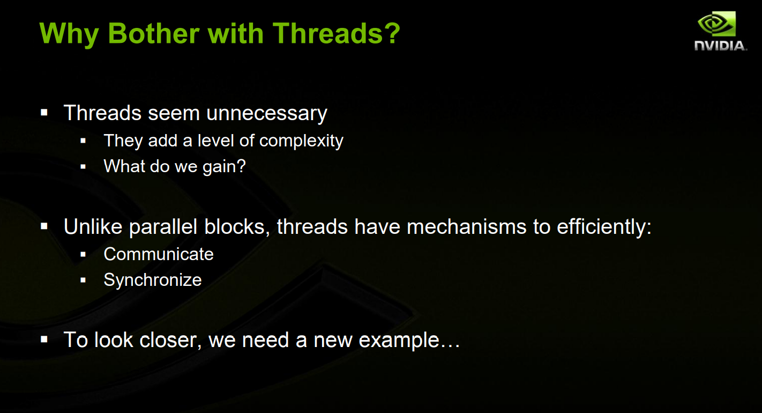

Slide 55


Slide 56


Slide 57


Slide 58


Slide 59


Slide 60


Slide 61


Slide 62


Slide 63


Slide 64


Slide 65


Slide 66


Slide 67


